Slide 1
IntuceoTM Platform
Predictive Analytics Technology

Slide 2
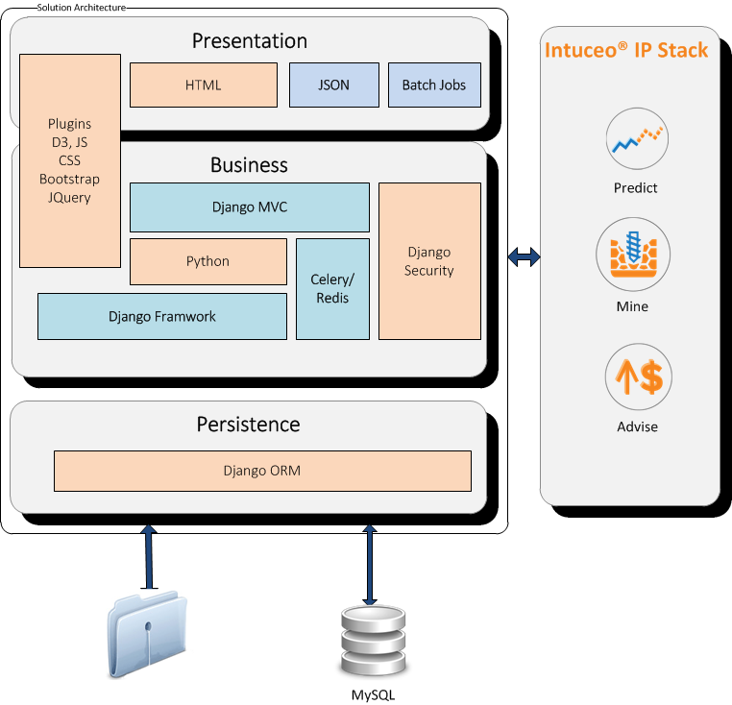
Intuceo technology stack

Slide 3
Intuceo architecture
MYSQL
Files
Request
Apache
Intuceo
Business
Logic
(Pyhton)
Task Manager
(Celery)
Q
Manager
(RabbitMQ)
Task
Manager
(Celery)
IP
Tasks
(R)
USER
(D3JS, html,
CSS
Amcharts
Bootstrap
Jquery
JSON)
RPY2
Response
Workers
Intuceo
Web Application

Slide 4
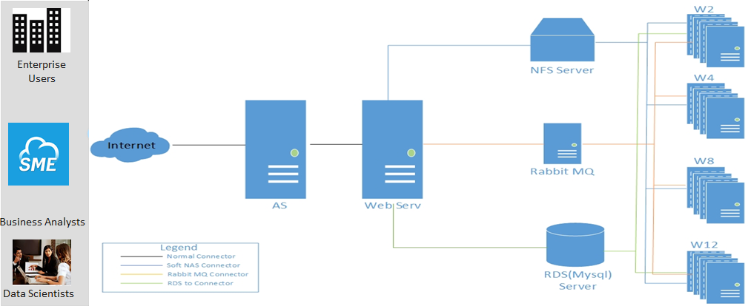
Intuceo cloud architecture
Note: The functionality for auto span and termination of workers is specific to AWS cloud,
this has to beplemented afresh in case of a different cloud.

Slide 5
Footprints
Name | Function | CPU Cores | Memory | Storage
AS | Authentication | 2 | 4GB | 10G
WebServ | Web Services | 8 | 15GB | 10G
Rabbit MQ | Queuing | 2 | 8GB | 10G
W2 | Worker 2 | 2 | 4GB | 10G
W4 | Worker 4 | 4 | 8GB | 10G
W8 | Worker 8 | 8 | 16GB | 10G
W12 | Worker 12 | 16 | 32GB | 10G
NFS | NFS storage | N/A | N/A | 250G/10G per user
RDS | MYSQL Server | N/A | N/A | 100MB per User
Note: Bandwidth consumption would be just like any other normal webserver.
It needs more Bandwidth when downloading and uploading the datasets.

Slide 6
Intuceo Images
Authentication Server:
Ubuntu 14.04
Apache 2.4
libapache2-mod-wsgi
mysql-server-5.6
Python 2.7.6
dos2unix
openjdk-7-jdk
libcurl4-openssl-dev
Intuceco Web Server:
Ubuntu 14.04
libcurl4-openssl-dev
Apache 2.4
libapache2-mod-wsgi
openjdk-7-jdk
R (r-base) 3.1.3
R Packages
Python 2.7.6
python-pip
python-dev
build-essential
Supervisor-3.0
libmysqlclient-dev
libreadline-dev
Django 1.6.5
Amcharts
D3.js
Python Libs
RabbitMQ Server:
Ubuntu 14.04
Rabbitmq 3.1.3
openjdk-7-jdk
Supervisor-3.0
Worker Q2,Q4,Q8,Q12:
Ubuntu 14.04
openjdk-7-jdk
libcurl4-openssl-dev
R (r-base) 3.1.3
Python 2.7.6
python-pip
python-dev
build-essential
libmysqlclient-dev
libreadline-dev
Supervisor(latest version)

Slide 7
Intuceo powered sample solution architecture

Slide 8
Thank you

